Slide 1
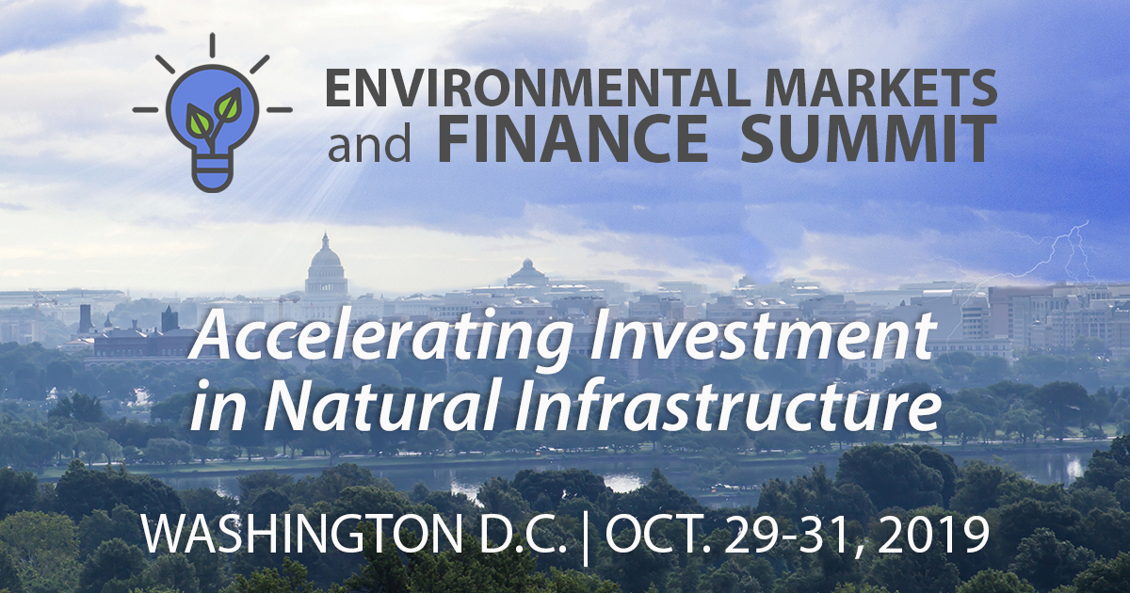
envmarketsandfinancesummit.com

